Slide 1

Learning by Exploration
Qingyun Wu, Huazheng Wang, Hongning Wang
Department of Computer Science
University of Virginia

Slide 2
Outline of this tutorial
Motivation
Classical exploration strategies
Efficient exploration in complicated real-world environments
Exploration in non-stationary environments
Ethical considerations of exploration
Conclusion & future directions

Slide 3
Efficient exploration in complicated real-world environments
Collaborative bandit learning
Low rank structures
Warm-start exploration

Slide 4




Collaborative bandit learning
$N$ users, each user has his/her own $θ$
  Build independent LinUCB for each user?
  Cold start challenge in personalized systems
  Users are not independent
Leverage user dependency for efficient exploration
  Use existing user dependency information
  Discover dependency online (via clustering)

Slide 5
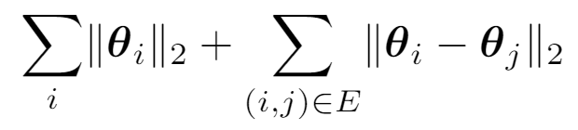
Collaborative bandit learning
GOBLin [CGZ13]
  Graph Laplacian based regularization upon ridge regression to model dependency
  Connected users are assumed to share similar model parameters
Graph $E$ is input. Regularization term:

Slide 6
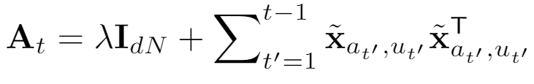
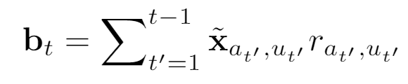


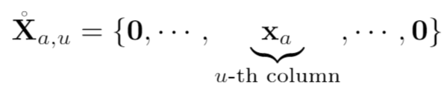
Collaborative bandit learning
GOBLin [CGZ13]
  Graph Laplacian based regularization upon ridge regression to model dependency
  Encode graph Laplacian in context, formulate as a dN-dimensional LinUCB
Closed form estimator
Graph Laplacian

Slide 7












Collaborative bandit learning
CoLin [WWGW16]
  Social influence among users: content and opinion sharing in social network $W$
  Reward: weighted average of expected reward among friends
  A dN-dimensional LinUCB
in which
Closed form estimator
When $W$ is uniform, i.e, all users are uniformly connected to share:
Regret:
0.6 | 0.1 | 0.2 | 0.0
0.0 | 0.7 | 0.0 | 0.0
0.0 | 0.1 | 0.8 | 0.5
0.4 | 0.1 | 0.0 | 0.5

Slide 8

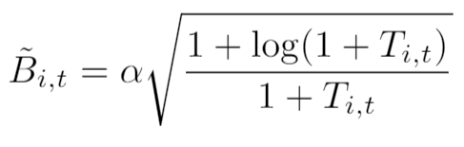

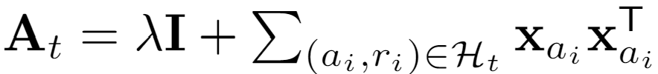

Online Clustering
Remove edge if
CLUB[GLZ14]
  Adaptively cluster users into groups by keep removing edges
  Threshold to remove edges is based on closeness of the users’ models
  Build LinUCB on each cluster
Regret: . Reduce regret from n (users) to m (clusters)
Closed form estimator

Slide 9




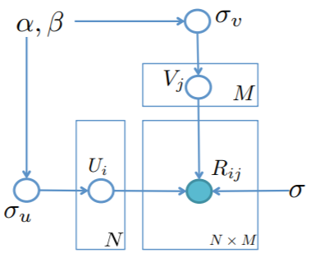
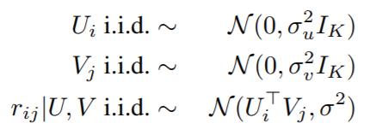
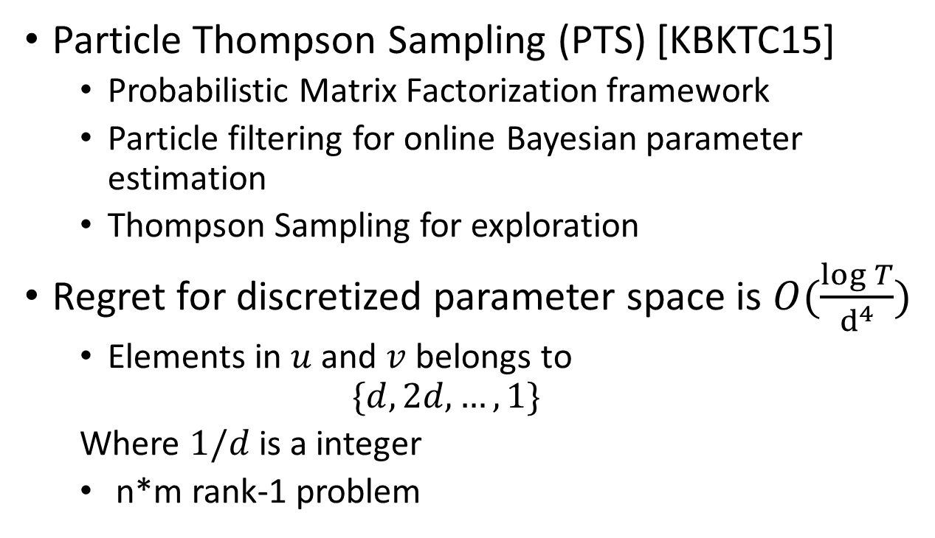
Low rank structures
Particle Thompson Sampling (PTS) [KBKTC15]
  Probabilistic Matrix Factorization framework
  Particle filtering for online Bayesian parameter estimation
  Thompson Sampling for exploration
Regret for discretized parameter space is $O(\frac{\log{T}}{d^{4}})$
  Elements in $u$ and $v$ belongs to
  $$\{d,2d,…,1\}$$
  Where $1/d$ is a integer
  n*m rank-1 problem
0.6 | ? | 0.2 | ?
0.5 | 0.7 | ? | 0.1
? | 0.1 | ? | ?
? | 0.1 | ? | 0.5
Generative Model

Slide 10
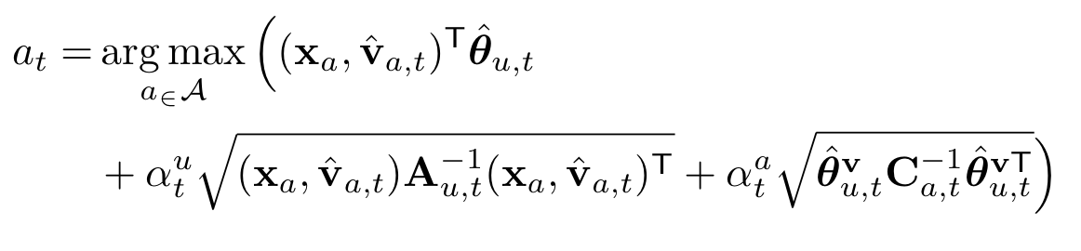
Low rank structures
Hidden LinUCB [WWW16]
  Matrix Factorization framework: user & item factors
  Alternating Least Squares for optimization
  Exploration considers uncertainty from two factors
Source of uncertainty in confidence bound estimation
Hidden feature (of an item): known to the environment, but unknown to the learner
Uncertainty of user preference $θ_{u}$ estimation
Uncertainty of hidden feature $v_{a}$ estimation

Slide 11
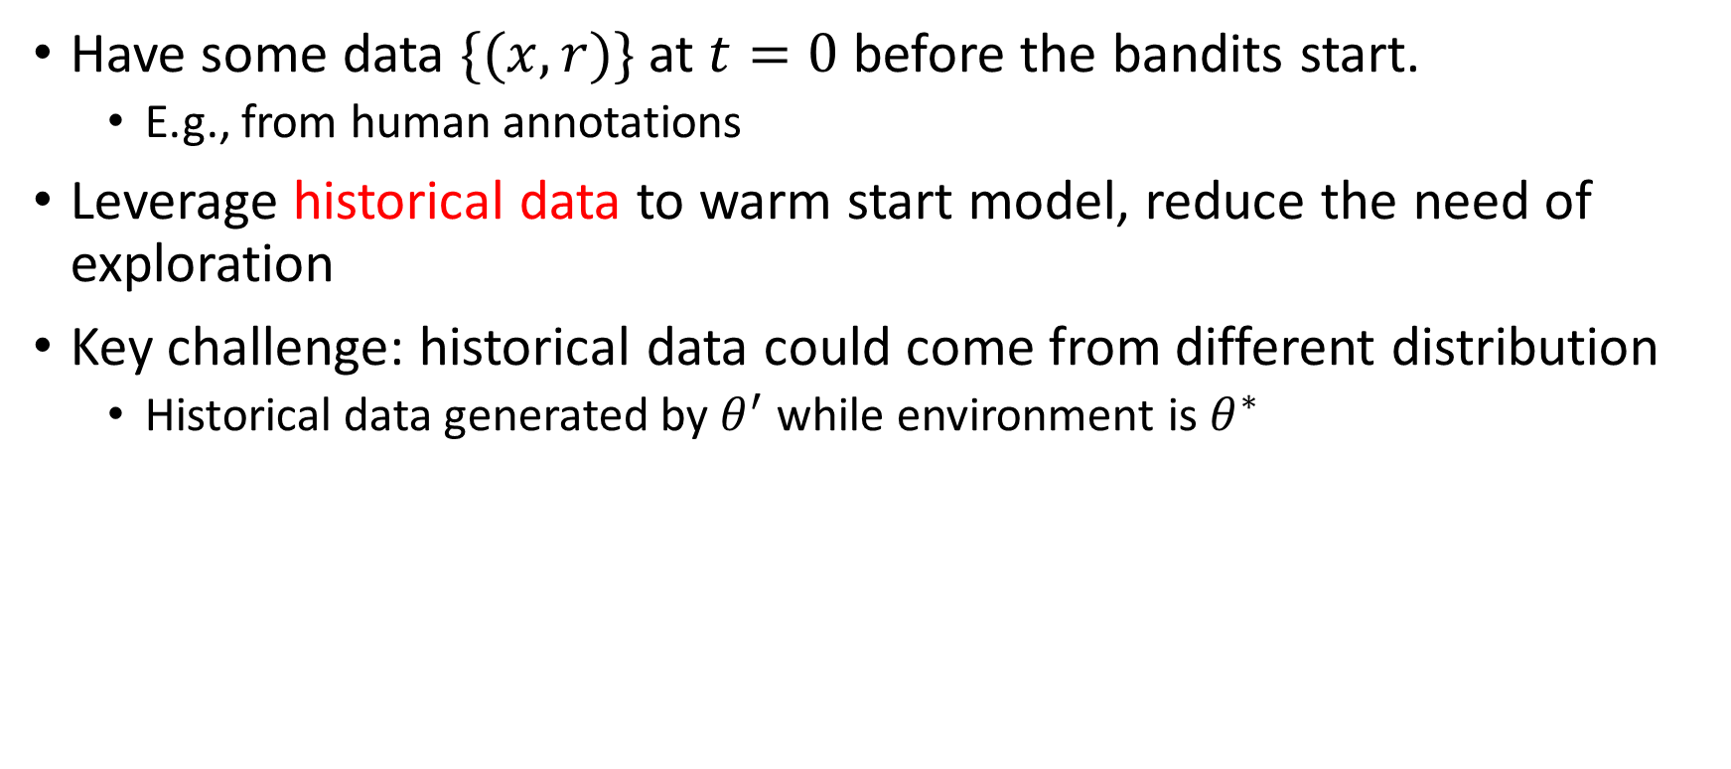
Warm-start exploration
Have some data $\{(x, r)\}$ at $t=0$ before the bandits start.
  E.g., from human annotations
Leverage historical data to warm start model, reduce the need of exploration
Key challenge: historical data could come from different distribution
  Historical data generated by $θ^{′}$ while environment is $θ^{∗}$

Slide 12
Warm-start exploration
Leverage historical data to warm start model, reduce the need of exploration
Adaptive Reweighting (ARROW-CB) [ZADLN19]
  Reweight historical data based on bandits’ observation
  Online model selection to pick the weight
Regret reduction when historical data and environment have similar distribution

Slide 13
Open questions
What is the problem-related (structure-related) regret lower bound
  Did current algorithms fully utilize the information in problem structure?
Efficient exploration for other structures in real-world problem
  E.g., sparse structure, ranking structure, etc.

Slide 14
References III
[CGZ13] Cesa-Bianchi, N., Gentile, C., & Zappella, G. (2013). A gang of bandits. In Advances in Neural Information Processing Systems (pp. 737-745).
[WWGW16] Wu, Q., Wang, H., Gu, Q., & Wang, H. (2016, July). Contextual bandits in a collaborative environment. In Proceedings of the 39th International ACM SIGIR conference on Research and Development in Information Retrieval (pp. 529-538).
[GLZ14] Gentile, C., Li, S., & Zappella, G. (2014, January). Online clustering of bandits. In International Conference on Machine Learning (pp. 757-765).
[GLKKZE17] Gentile, C., Li, S., Kar, P., Karatzoglou, A., Zappella, G., & Etrue, E. (2017, July). On context-dependent clustering of bandits. In International Conference on Machine Learning (pp. 1253-1262).
[LKG16] Li, S., Karatzoglou, A., & Gentile, C. (2016, July). Collaborative filtering bandits. In Proceedings of the 39th International ACM SIGIR conference on Research and Development in Information Retrieval (pp. 539-548).
[KBKTC15] Kawale, J., Bui, H. H., Kveton, B., Tran-Thanh, L., & Chawla, S. (2015). Efficient Thompson Sampling for Online￼ Matrix-Factorization Recommendation. In Advances in neural information processing systems (pp. 1297-1305).
[WWW16] Wang, H., Wu, Q., & Wang, H. (2016, October). Learning hidden features for contextual bandits. In Proceedings of the 25th ACM International on Conference on Information and Knowledge Management (pp. 1633-1642).
[ZADLN19] Zhang, C., Agarwal, A., Daumé III, H., Langford, J., & Negahban, S. N. (2019). Warm-starting contextual bandits: Robustly combining supervised and bandit feedback. arXiv preprint arXiv:1901.00301.

